Slide 1

Lecture 7: Basics of JavaScript
Open Source Web Software

Slide 2
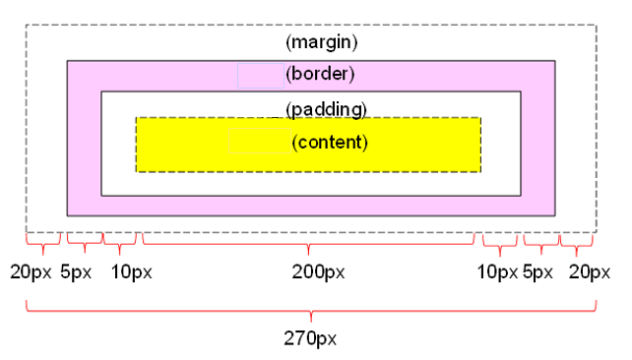
In Last Lecture
CSS Box Model
CSS Box Model consists of the followings:
margins, borders, padding, and the actual content
Width and height of an Element
How to calculate box size

Slide 3
In Last Lecture
CSS Display
display: block
display: inline
display: none
visibility: hidden
display: inline-block
The position property specifies the type of positioning method used for an element
Static positioning
Relative positioning
Absolute positioning
Fixed positioning

Slide 4
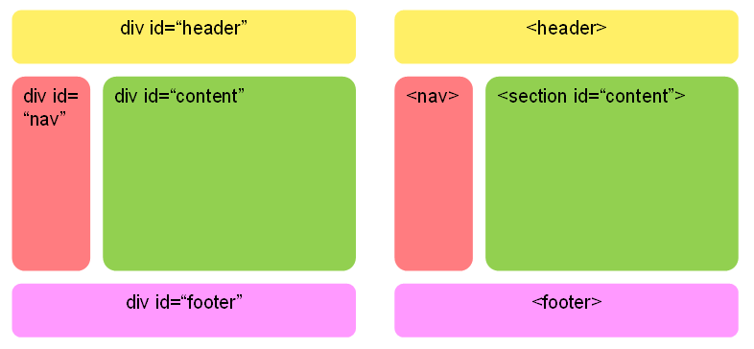
In Last Lecture
CSS Layout

Slide 5
Table of Contents
Part 1.
What is JavaScript?
Part 2.
JavaScript Basic Syntax
Part 3
JavaScript Practice

Slide 6
What is javascript?
Part 1

Slide 7
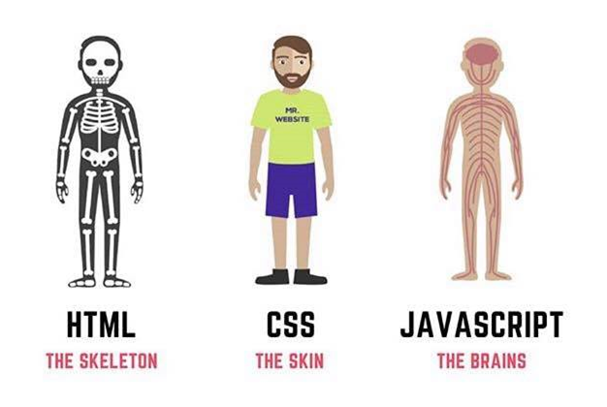
What is JavaScript?
JavaScript is the programming language of the Web

Slide 8
What is JavaScript?
Features of JavaScript
Interpreted language
Dynamic typing
Functional programming (like C Language)
Object oriented programming (like C++ or Java)
JavaScript is a scripting language and it is not Java
It is easy to learn

Slide 9
What is JavaScript?
Location of JavaScript
External JavaScript
Inner JavaScript
Inline JavaScript

Slide 10
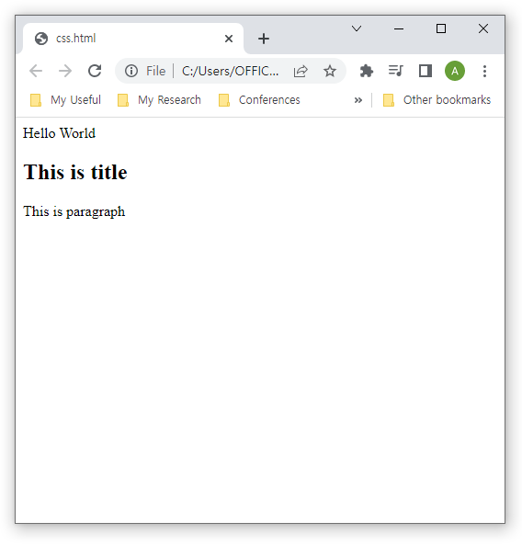
What is JavaScript?
External JavaScript
Located as separate file with .js extension
<!DOCTYPE html>
<html>
<head>
<script src="myscript.js"></script>
</head>
<body>
<h2>This is title</h2>
<p>This is paragraph</p>
</body>
</html>
myscript.js
document.write("Hello World")

Slide 11
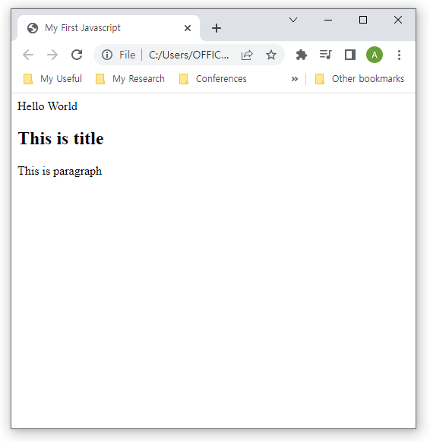
What is JavaScript?
Inner JavaScript
Located in header of HTML document between <script> and </script>
<!DOCTYPE HTML>
<html>
<head>
<title>My First Javascript</title>
<script>
document.write("Hello World")
</script>
</head>
<body>
<h2>This is title</h2>
<p>This is paragraph</p>
</body>
</html>

Slide 12
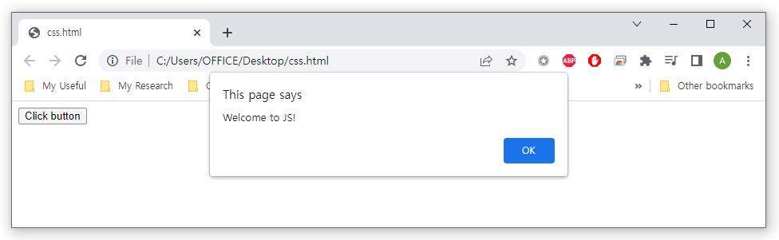
What is JavaScript?
Inline JavaScript
Located inside of HTML element
<!DOCTYPE html>
<html>
<body>
<button type="button" onclick ="alert('Welcome to JS!')">Click button</button>
</body>
</html>

Slide 13
Javascript syntax
Part 2

Slide 14
JavaScript Syntax
JavaScript Output
JavaScript can "display" data in different ways
Writing into an HTML element, using innerHTML
Writing into the HTML output using document.write()
Writing into an alert box, using window.alert()
Writing into the browser console, using console.log()

Slide 15
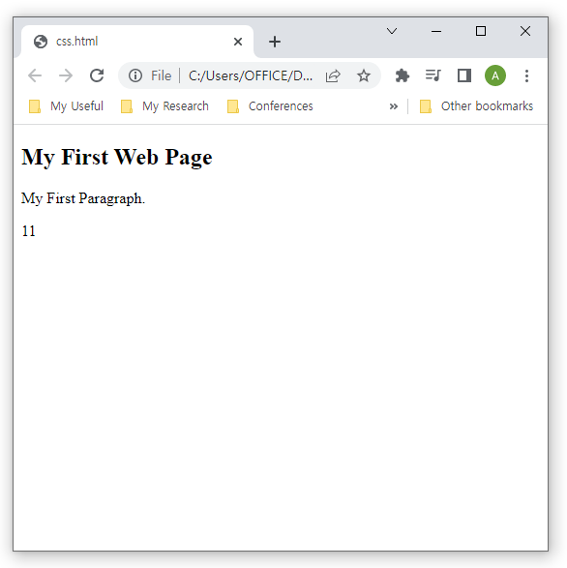
JavaScript Syntax
Using innerHTML
To access an HTML element, JavaScript can use the document.getElementById(id) method.
The id attribute defines the HTML element
The innerHTML property defines the HTML content
<!DOCTYPE html>
<html>
<body>
<h2>My First Web Page</h2>
<p>My First Paragraph.</p>
<p id="demo"></p>
<script>
document.getElementById("demo").innerHTML = 5 + 6;
</script>
</body>
</html>

Slide 16
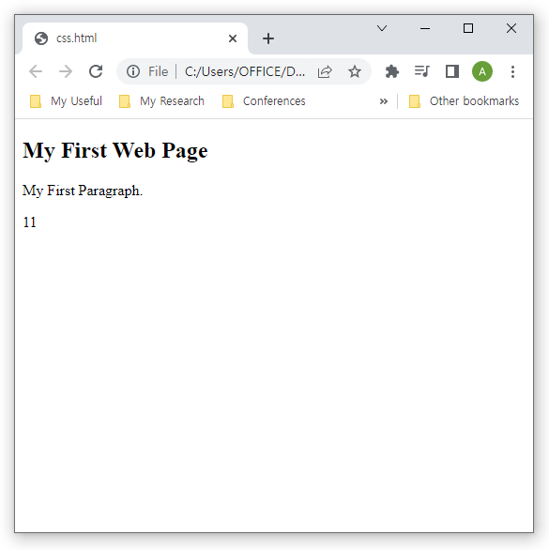
JavaScript Syntax
Using document.write()
For testing purposes, it is convenient to use document.write()
<!DOCTYPE html>
<html>
<body>
<h2>My First Web Page</h2>
<p>My First Paragraph.</p>
<script>
document.write(5 + 6);
</script>
</body>
</html>

Slide 17
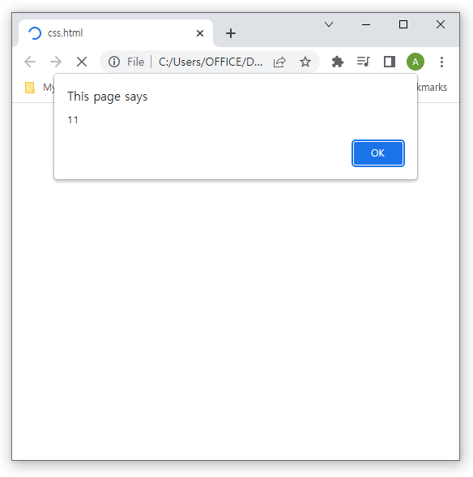
JavaScript Syntax
Using window.alert()
You can use an alert box to display data
<!DOCTYPE html>
<html>
<body>
<h2>My First Web Page</h2>
<p>My First Paragraph.</p>
<script>
window.alert(5 + 6);
</script>
</body>
</html>

Slide 18
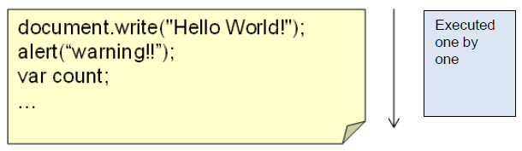
JavaScript Syntax
JavaScript Statement
JavaScript statements are commands to the web browser
JavaScript Comments
Single line comments start with //
Multi line comments start with /* and end with */

Slide 19
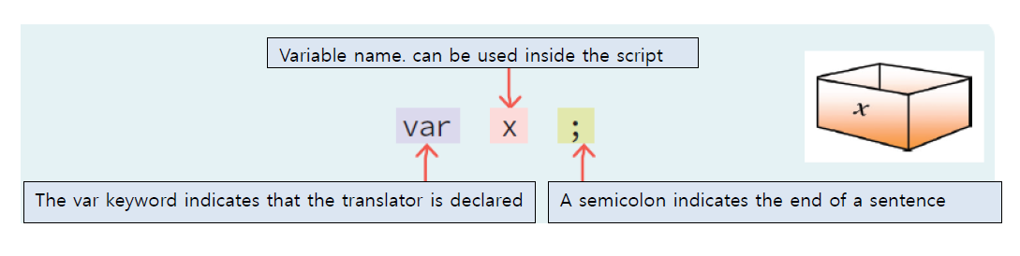
JavaScript Syntax
JavaScript Variables
Variable is a space for storing data
Declare variables using var keyword

Slide 20
JavaScript Syntax
JavaScript Variables
All JavaScript variables must be identified with unique names
Identifiers
The general rules for constructing names for variables (unique identifiers) are:
Names can contain letters, digits, underscores, and dollar signs
Names must begin with a letter
Names can also begin with $ and _
Names are case sensitive (y and Y are different variables)
Reserved words (like JavaScript keywords) cannot be used as names

Slide 21
JavaScript Syntax
JavaScript Variables
Reserved keywords

Slide 22
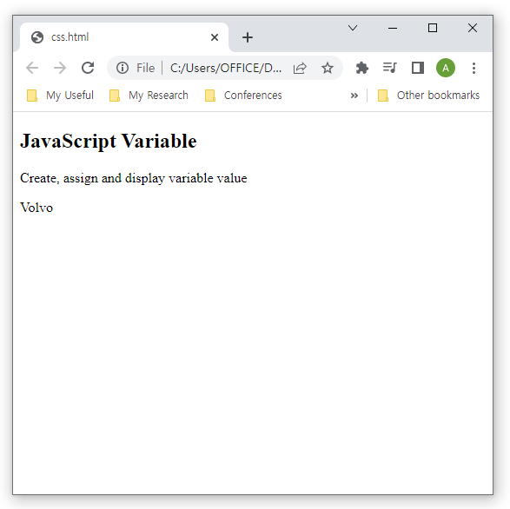
JavaScript Syntax
JavaScript Variables
Example
<!DOCTYPE html>
<html>
<body>
<h2>JavaScript Variable</h2>
<p>Create, assign and display variable value</p>
<p id="demo"></p>
<script>
var carName = "Volvo";
document.getElementById("demo").innerHTML
= carName;
</script>
</body>
</html>

Slide 23
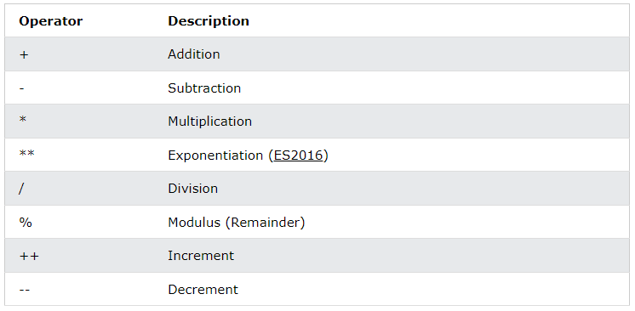
JavaScript Syntax
JavaScript Arithmetic
Arithmetic operators perform arithmetic on numbers

Slide 24
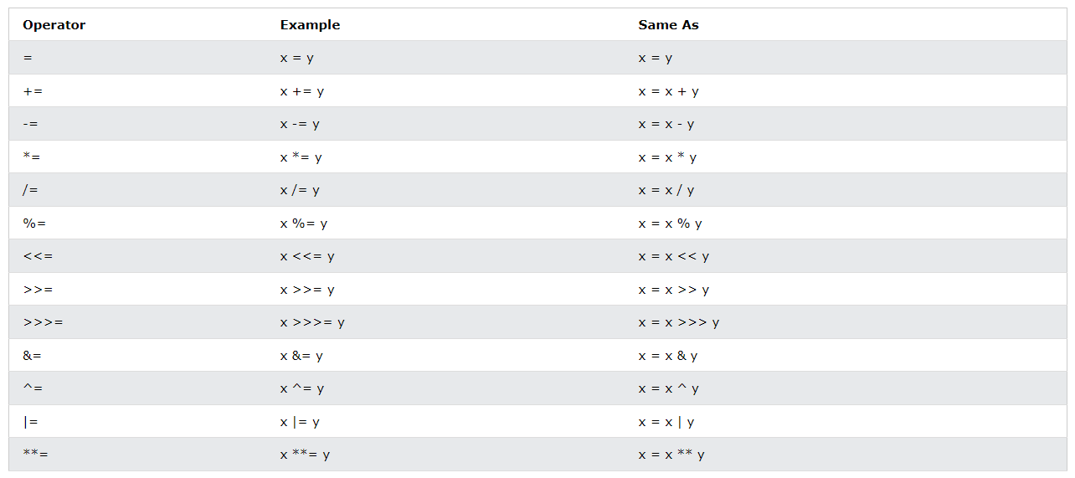
JavaScript Syntax
JavaScript Assignment Operators
Assignment operators assign values to JavaScript variables

Slide 25
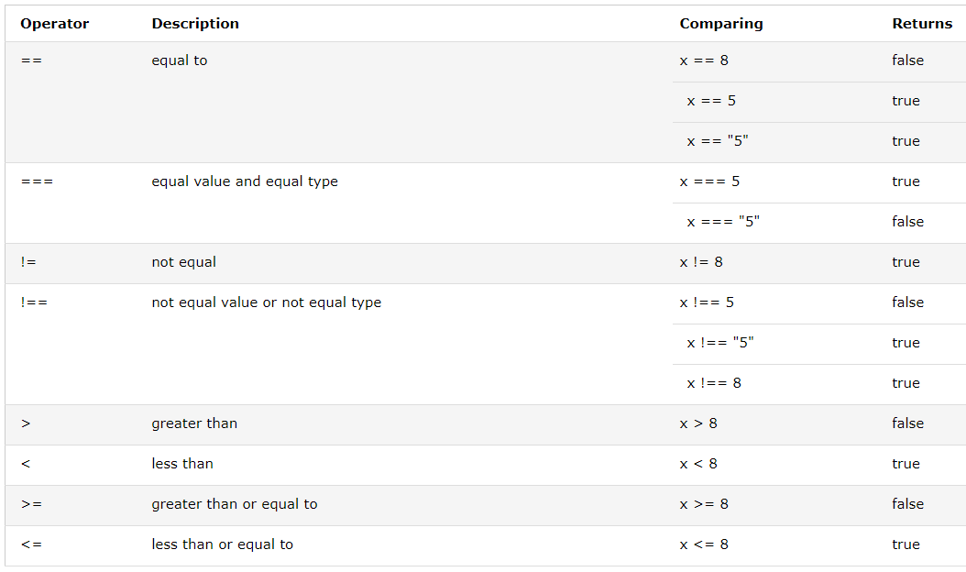
JavaScript Syntax
JavaScript Comparison Operators
Comparison operators are used in logical statements to determine equality or difference between variables or values

Slide 26
JavaScript Syntax
JavaScript Comparison Operators
==
Abstract Equality Comparison
"loose equality", "double equals"
Compare the identity of two operands even though, they are not of a similar type
===
Strict Equality Comparison
"strict equality", "triple equals“
Both the type and the value we are comparing have to be the same

Slide 27

JavaScript Syntax
JavaScript Comparison Operators
Difference between double equals and triple equals
<!DOCTYPE html>
<html>
<body>
<h2>JavaScript Comparsion</h2>
<p>The result of comparison:</p>
<p id="demo"></p>
<script>
var a = 10;
document.getElementById("demo").innerHTML
= (a == "10");
</script>
</body>
</html>

Slide 28

JavaScript Syntax
JavaScript Comparison Operators
Difference between double equals and triple equals
<!DOCTYPE html>
<html>
<body>
<h2>JavaScript Comparsion</h2>
<p>The result of comparison:</p>
<p id="demo"></p>
<script>
var a = 10;
document.getElementById("demo").innerHTML
= (a === "10");
</script>
</body>
</html>

Slide 29
JavaScript Syntax
JavaScript Data Types
JavaScript variables can hold different data types: numbers, strings, objects and more:
var length = 16; // Number
var lastName = "Johnson"; // String
var x = {firstName:"John", lastName:"Doe"}; // Object
When adding a number and a string, JavaScript will treat the number as a string
var x = 16 + "Volvo"; //Output: 16Volvo
var x = "Volvo" + 16; //Output: Volvo16
var x = 16 + 4 + "Volvo"; //Output: 20Volvo
var x = "Volvo" + 16 + 4; //Output: Volvo164

Slide 30
JavaScript Syntax
JavaScript Data Types
Example
var x = 5 + 5; //Output:
var y = "5" + 5; //Output:
Var z = "Hello" + 5; //Output:

Slide 31
JavaScript Syntax
JavaScript Data Types
JavaScript has dynamic types
The same variable can be used to hold different data types
Example
var x; // Now x is undefined
x = 5; // Now x is a Number
x = "John"; // Now x is a String

Slide 32
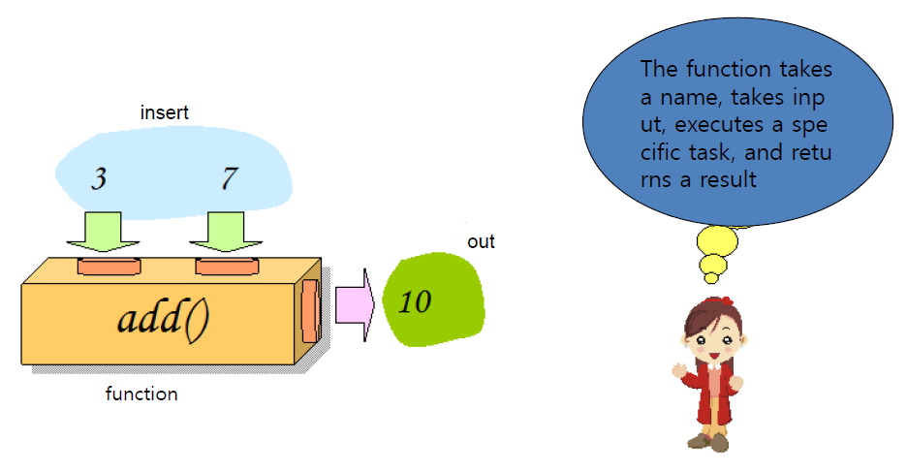
JavaScript Syntax
JavaScript Functions
Function is a black box that accepts input, performs a specific operation and returns a result

Slide 33
JavaScript Syntax
JavaScript Functions
Syntax
function name(parameter1, parameter2, parameter3) {
// code to be executed
}
Function Invocation
When it is invoked (called) from JavaScript code
Automatically (self invoked)
When an event occurs (when a user clicks a button)

Slide 34

JavaScript Syntax
When it is invoked from JavaScript code
Example
<!DOCTYPE html>
<html>
<body>
<h2>JavaScript Function</h2>
<p>Convert from Fahrenheit to Celsius</p>
<p id="demo"></p>
<script>
function toCelsius(f) {
return (5/9) * (f-32);
}
document.getElementById("demo").innerHTML =
toCelsius(77);
</script>
</body>
</html>

Slide 35
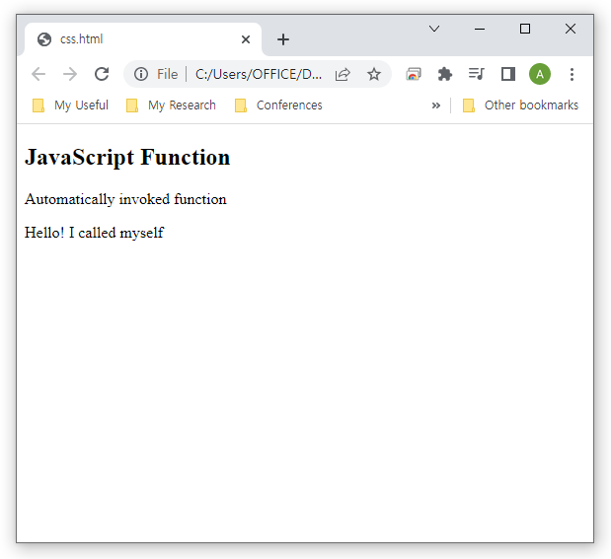
JavaScript Syntax
When it is invoked from JavaScript code
Function expressions will execute automatically if the expression is followed by ()
Example
<!DOCTYPE html>
<html>
<body>
<h2>JavaScript Function</h2>
<p>Automatically invoked function</p>
<p id="demo"></p>
<script>
(function () {
document.getElementById("demo").innerHTML
= "Hello! I called myself";
})();
</script>
</body>
</html>

Slide 36
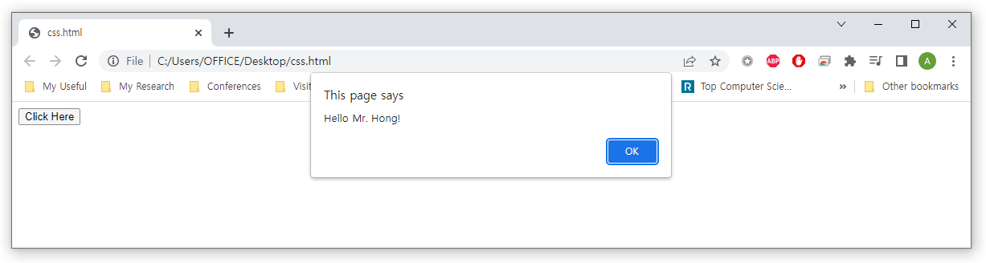
JavaScript Syntax
When an event occurs
Example
<script>
function greeting(title, name) {
alert("Hello" + " " + title + " " + name + "!");
}
</script>
<button onclick ="greeting('Mr.', 'Hong')">Click Here</button>

Slide 37
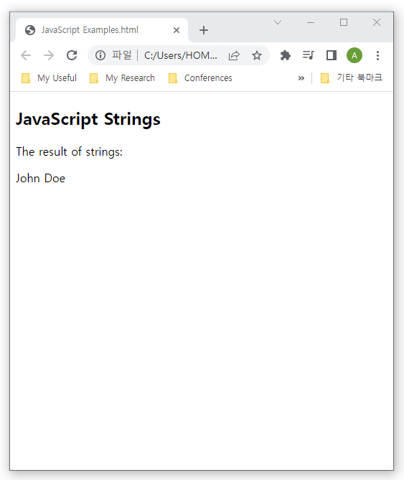
JavaScript Syntax
JavaScript Strings
A JavaScript string is zero or more characters written inside quotes
<!DOCTYPE html>
<html>
<body>
<h2>JavaScript Strings</h2>
<p>The result of strings:</p>
<p id="demo"></p>
<script>
var text = "John Doe";
document.getElementById("demo").innerHTML = text;
</script>
</body>
</html>

Slide 38
JavaScript Syntax
JavaScript Strings Methods
The length property returns the length of a string
var txt = "ABCDEFGHIJKLMNOPQRSTUVWXYZ";
var length = txt.length; //Output: 26
The slice() extracts a part of a string and returns the extracted part in a new string
var str = "Apple, Banana, Kiwi";
var part = str.slice(7, 13); //Output: Banana
var part = str.slice(-12, -6); //Output: Banana
var part = str.slice(7); //Output: Banana, Kiwi

Slide 39
JavaScript Syntax
JavaScript Strings Methods
The replace() method replaces a specified value with another value in a string
var text = "Hi!";
var newText = text.replace("Hi", "Hello"); //Output: Hello
A string is converted to upper case with toUpperCase() and to lower case with toLowerCase()
var text1 = "Hello World!";
var text2 = text1.toUpperCase(); //Output: HELLO WORLD!
var text2 = text1.toLowerCase(); //Output: hello world!

Slide 40
JavaScript Syntax
JavaScript Strings Methods
concat() joins two or more strings
var text1 = "Hello";
var text2 = "World";
var text3 = text1.concat(" ", text2); //Output: Hello World
var text4 = "Hello" + " " + "World!"; //Output: Hello World
The charAt() method returns the character at a specified index (position) in a string
var text = "HELLO WORLD";
var ch = text.charCodeAt(0); //Output: H
var char = text[0]; //Output: H

Slide 41
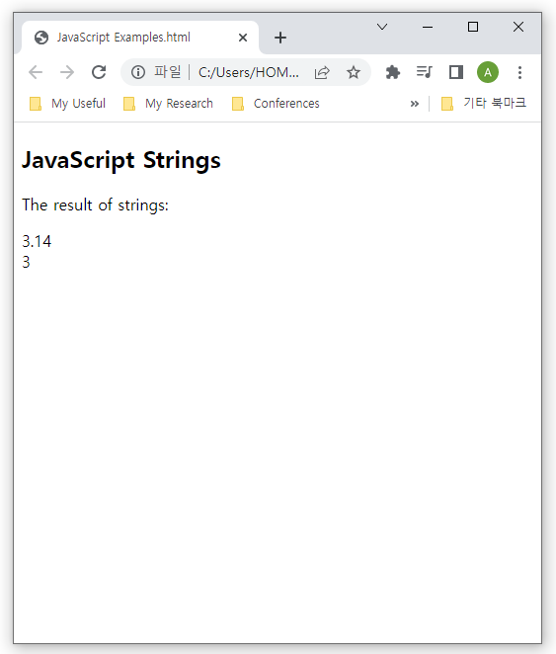
JavaScript Syntax
JavaScript Numbers
JavaScript has only one type of number
<!DOCTYPE html>
<html>
<body>
<h2>JavaScript Numbers</h2>
<p>The result of numbers:</p>
<p id="demo"></p>
<script>
var x = 3.14;
var y = 3;
document.getElementById("demo").innerHTML =
x + "<br>" + y;
</script>
</body>
</html>

Slide 42
JavaScript Syntax
JavaScript Number Methods
The toString() method returns a number as a string
var x = 123;
x.toString(); //Output: 123
(123).toString(); //Output: 123
(100 + 23).toString(); //Output: 123
The Number.isInteger() method returns true if a value is an integer of the datatype Number
Number.isInteger(123); //Output: true
Number.isInteger(-123); //Output: true
Number.isInteger('123'); //Output: false

Slide 43
JavaScript Syntax
JavaScript Number Methods
The Number() can be used to convert JavaScript variables to numbers
Number(true); //Output: 1
Number(false); //Output: 0
Number("10"); //Output: 10
Number(" 10"); //Output: 10
Number("10 "); //Output: 10
Number(" 10 "); //Output: 10
Number("10.33"); //Output: 10.33
Number("10,33"); //Output: NaN
Number("10 33"); //Output: NaN
Number("John"); //Output: NaN

Slide 44
JavaScript Syntax
JavaScript Number Methods
The parseInt() parses a string and returns a whole number
parseInt("-10"); //Output: -10
parseInt("-10.33"); //Output: -10
parseInt("10"); //Output: 10
parseInt("10.33"); //Output: 10
parseInt("10 20 30"); //Output: 10
parseInt("10 years"); //Output: 10
parseInt("years 10"); //Output: NaN
The parseFloat() is for converting a non float to a float

Slide 45
JavaScript Syntax
JavaScript Array
Creating arrays by literal
var cars = ["Saab", "Volvo", "BMW"];
You access an array element by referring to the index number
var cars = ["Saab", "Volvo", "BMW"];
var car = cars[0]; //Output: Saab
Changing an array element
var cars = ["Saab", "Volvo", "BMW"];
cars[0] = "Opel";

Slide 46
JavaScript Syntax
JavaScript Array
Creating arrays by objects
var cars = new Array("Saab", "Volvo", "BMW");
These two different statements both create a new array
var points = new Array(40, 100, 1, 5, 25, 10);
var points = [40, 100, 1, 5, 25, 10];
The new keyword can produce some unexpected results:
var points = new Array(40);
var points = [40];

Slide 47
JavaScript Syntax
JavaScript Array Methods
The pop() method removes the last element from an array
var fruits = ["Banana", "Orange", "Apple", "Mango"];
fruits.pop(); //Output: Banana,Orange,Apple
The push() method adds a new element to an array at the end
var fruits = ["Banana", "Orange", "Apple", "Mango"];
fruits.push("Kiwi"); //Output: Banana,Orange,Apple,Mango,Kiwi
Array length
var fruits = ["Banana", "Orange", "Apple", "Mango"];
fruits[fruits.length] = "Kiwi";
//Output: Banana,Orange,Apple,Mango,Kiwi

Slide 48


JavaScript Syntax
JavaScript Array Methods
Merging (Concatenating) Arrays using concat()
var fruits = ["Kiwi", "Apple"];
var vegs = ["Tomato", "Cucumber"];
var discuss = fruits.concat(vegs);
The splice() method can be used to add new items to an array
var fruits = ["Banana", "Orange", "Apple", "Mango"];
fruits.splice(2, 2, "Lemon", "Kiwi");
//Output: Banana,Orange,Lemon,Kiwi
The slice() method slices out a piece of an array into a new array
var fruits = ["Banana", "Orange", "Lemon", "Apple", "Mango"];
var citrus = fruits.slice(3); //Output: Apple, Mango

Slide 49
JavaScript Syntax
JavaScript Array Methods
The sort() method sorts an array alphabetically
var fruits = ["Banana", "Orange", "Apple", "Mango"];
fruits.sort();
//Output: Apple,Banana,Mango,Orange
By default, the sort() function sorts values as strings, and thus. the sort() method will produce incorrect result when sorting numbers
var points = [40, 100, 1, 5, 25, 10];
points.sort() //Output: 1,10,100,25,40,5
Use compare function
var points = [40, 100, 1, 5, 25, 10];
points.sort(function(a, b){return a - b}); //Output: 1,5,10,25,40,100

Slide 50
JavaScript Syntax
JavaScript Controls
Conditional statements are used to perform different actions based on different conditions.
Types of JavaScript Controls
Use if to specify a block of code to be executed, if a specified condition is true
Use else to specify a block of code to be executed, if the same condition is false
Use else if to specify a new condition to test, if the first condition is false
Use switch to specify many alternative blocks of code to be executed

Slide 51
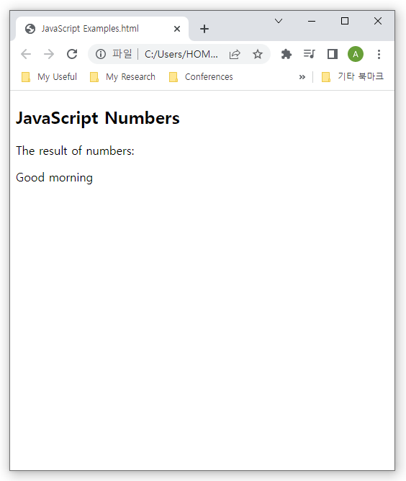
JavaScript Syntax
JavaScript Controls
Example
<h2>JavaScript Controls</h2>
<p>The result of controls:</p>
<p id="demo"></p>
<script>
var time = new Date().getHours();
var greeting;
if (time < 10) {
greeting = "Good morning";
} else if (time < 20) {
greeting = "Good day";
} else {
greeting = "Good evening";
}
document.getElementById("demo").innerHTML = greeting;
</script>

Slide 52
JavaScript Syntax
JavaScript Loops
Loops can execute a block of code a number of times.
Types of JavaScript loops
for - loops through a block of code a number of times
for/in - loops through the properties of an object
for/of - loops through the values of an iterable object
while - loops through a block of code while a specified condition is true
do/while - also loops through a block of code while a specified condition is true

Slide 53
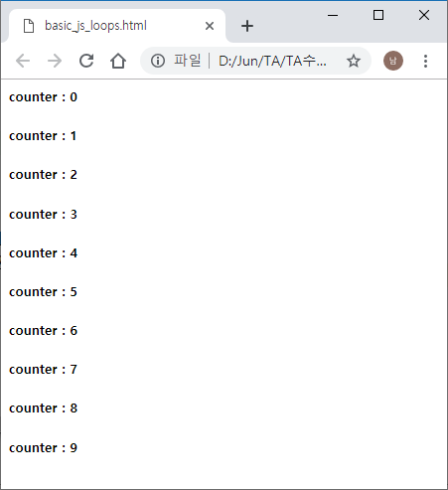
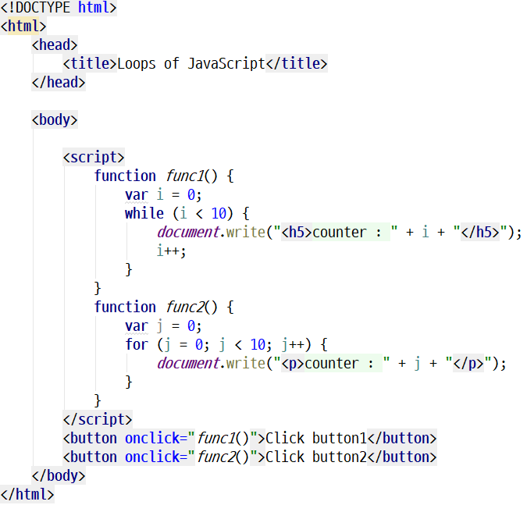
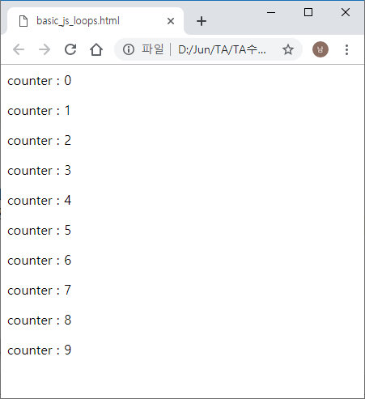
JavaScript Syntax
JavaScript Loops

Slide 54
Summary and Discussions
JavaScript Features
Interpreted language
Dynamic typing
Functional programming (like C Language)
Object oriented programming (like C++ or Java)
JavaScript is a scripting language and it is not Java
It is easy to learn
Location of JavaScript
External JavaScript
Inner JavaScript
Inline JavaScript

Slide 55
Summary and Discussions
JavaScript Syntax
JavaScript Output
JavaScript Statement
JavaScript Comments
JavaScript Variable
JavaScript Operators
JavaScript Data Types
JavaScript Function
JavaScript Strings
JavaScript Numbers
JavaScript Arrays
JavaScript Controls
JavaScript Loops

Slide 56
Practice
Part 4

Slide 57
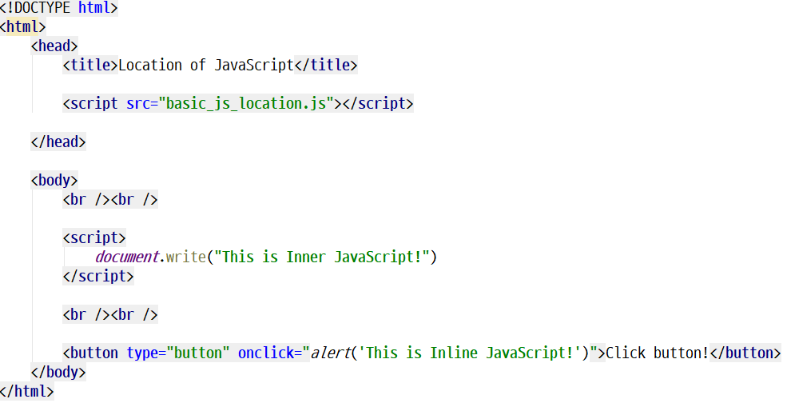
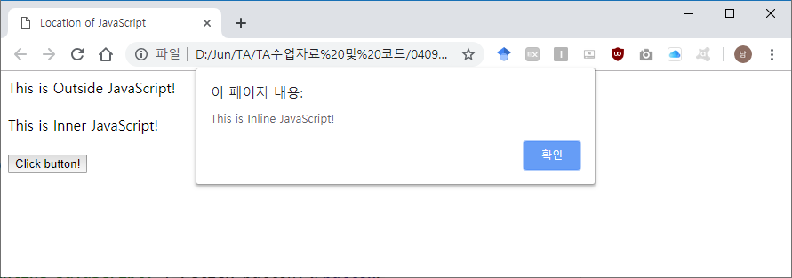
JavaScript Practice
JavaScript Outside
basic_js_location.js
Outside
Inner
Inline
basic_js_location.html

Slide 58
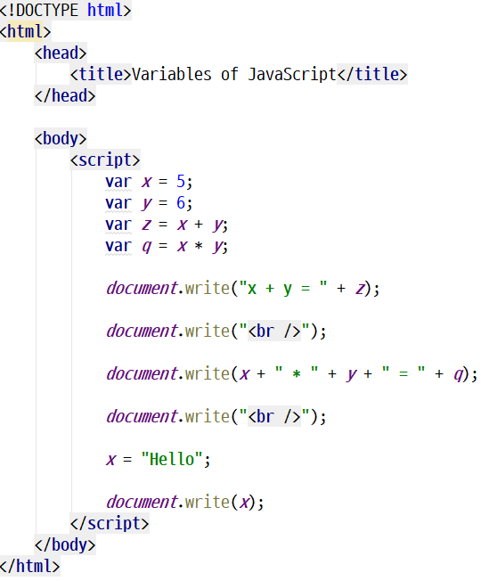
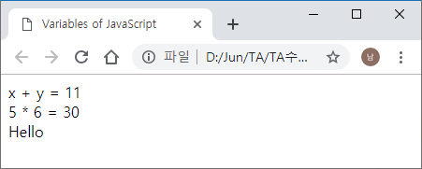
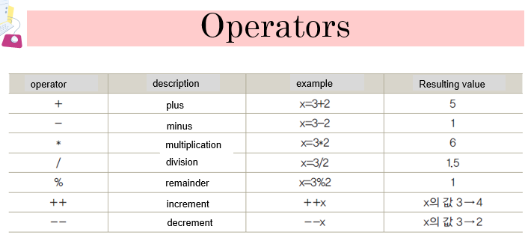
JavaScript Practice
JavaScript Variables
basic_js_variables.html

Slide 59
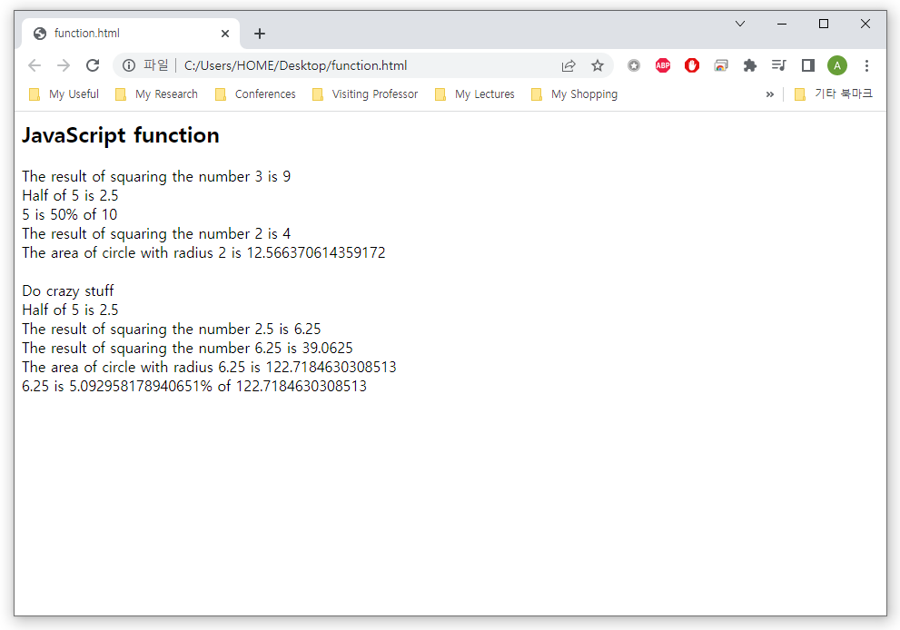
JavaScript Practice
Task 1 (JavaScript Functions)
Create several functions to calculate numbers

Slide 60
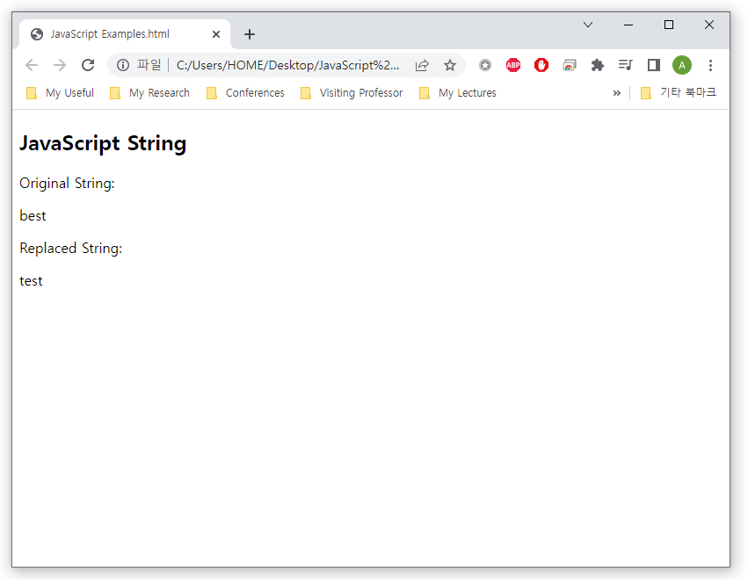
JavaScript Practice
Task 2 (JavaScript Strings)
Create a website to return a new string with the first character replaced

Slide 61
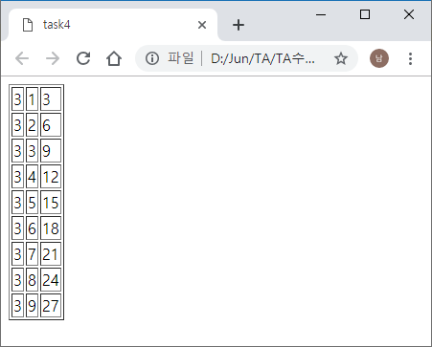
JavaScript Practice
Task 3 (JavaScript Loops)
Create a website to output a multiplication table

Slide 62
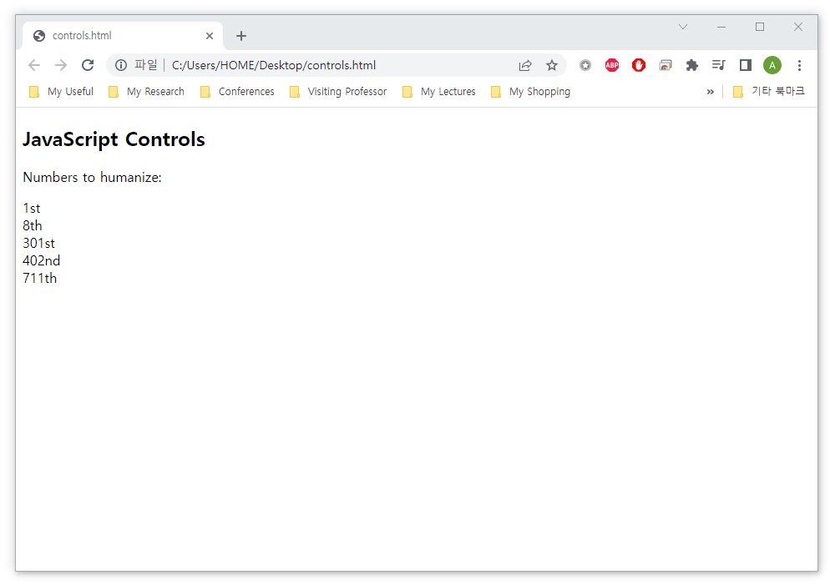
JavaScript Practice
Task 4 (JavaScript Controls)
Write a JavaScript function to humanized number with the correct suffix such as 1st, 2nd, 3rd or 4th
If the number ends in 11, 12, or 13, its ordinal ends in th

Slide 63
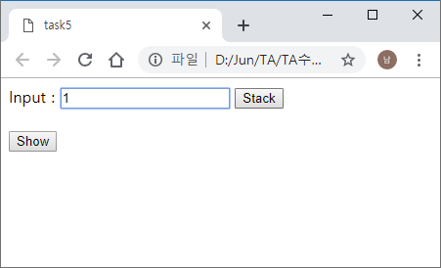
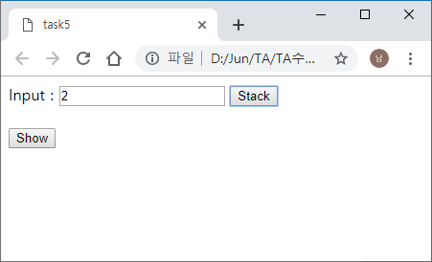
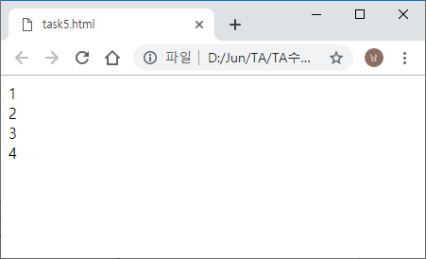


JavaScript Practice
Task 5 (JavaScript Arrays)
Input any value in the box
When the “Stack” button is clicked, store the value in the array
When the “Show” button is clicked, show the value of the array

Slide 64
See you next time!
Questions?

